Slide 1


Clickbait Spoiling
Team name: Natural Language Processors
Members:
Naman Khurpia
Mohammed Junaid Shaik
Mamatha Yarramaneni

Slide 2
Problem Statement - Clickbait Spoiling
Task 1 is to categorize the spoilers into phrase, passage and multipart spoilers.
Task 2 is to generate the spoiler from the given clickbait post
Various natural language algorithms can be used to create a model that classifies and summarizes clickbait posts.
We are going to be using the 3200 training set and the 800 test data set provided in the course material
Short phrase spoilers, Longer passage spoilers, and Multiple non-consecutive pieces of text are the various spoilers that we will be classifying into.
We will be using json format to first pre-train the data.
Notes:
M

Slide 3
Literature Survey
Clickbait detection and the personalized blocking by Chakraborty et al. (2016)
Clickbait Challenge 2017, Regression Model for Clickbait detection and strength by Potthast et al. (2018)
Headline Generation for Clickbait Detection by Shu et al. (2018) and
Headline Generation for Clickbait Detection using auto-tuned reinforcement learning by Xu et al. (2019)
Clickbait Spoiler generation introduced by Hagen et al.(2022)
Thai Clickbait Detection Algorithms Using Natural Language Processing with Machine Learning Techniques
Question-Answering Models
Clickbait spoiling as a question-answering problem
SQuAD v1.1 (107,785 questions and answers) and TriviaQA (95000 questions and answers)
BERT, Big Bird, DeBERTa, ELECTRA, MPNet, RoBERTa
Passage Retrieval
Benchmark - MS MARCO
MonoBERT, MonoT5, BM25, Query Likelihood
Notes:
M

Slide 4
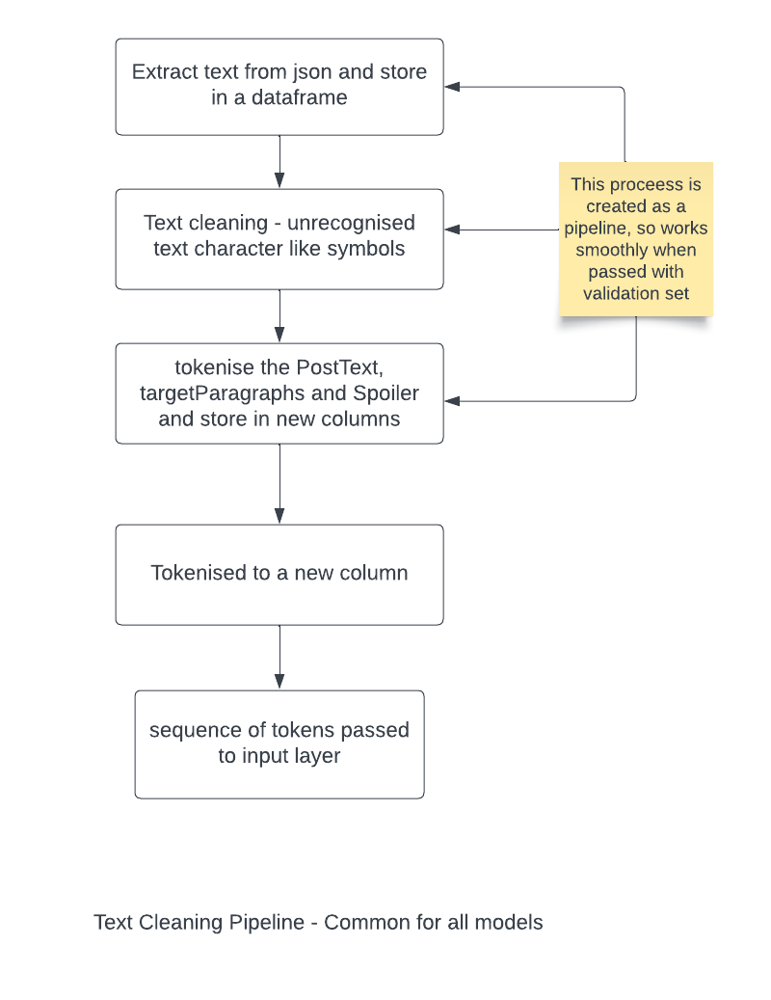
TASK 1 & 2 - Cleaning Pipeline
Notes:
M

Slide 5
TASK 1 - Clickbait classification - Models Tested
Model name
bert-base-cased
bert-large
distilbert-base-cased
roberta-base
roberta-large
deberta-base
deberta-large
Input text: (postText + targetParagraph)
Output: tag(phrase/passage/multi)
Notes:
M

Slide 6
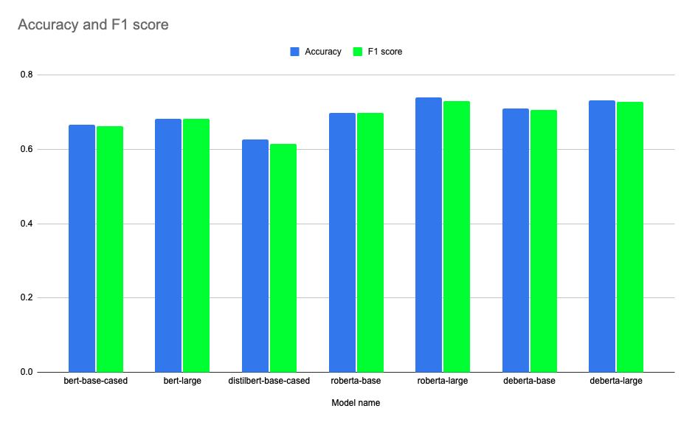
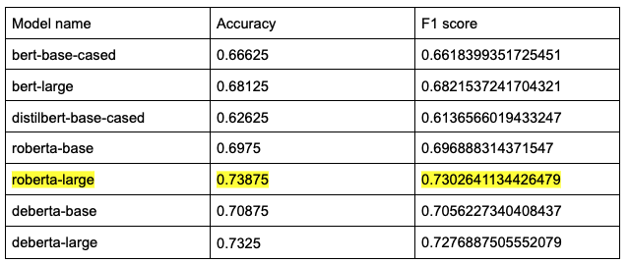
TASK 1 - Results
Notes:
M

Slide 7
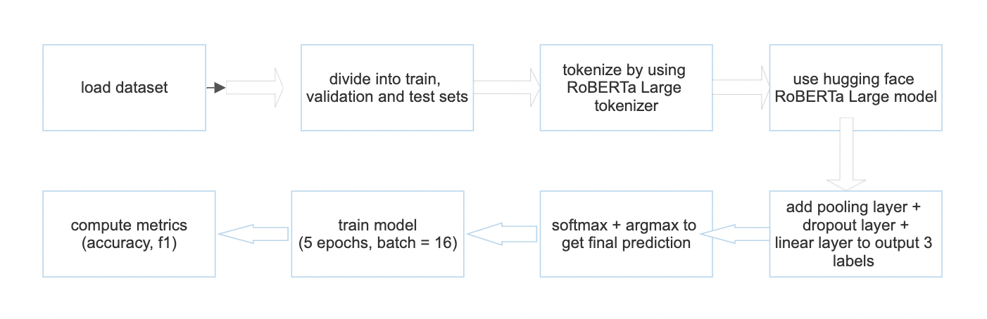
Task 1 - RoBERTa Large Architecture
(State of the Art)

Slide 8
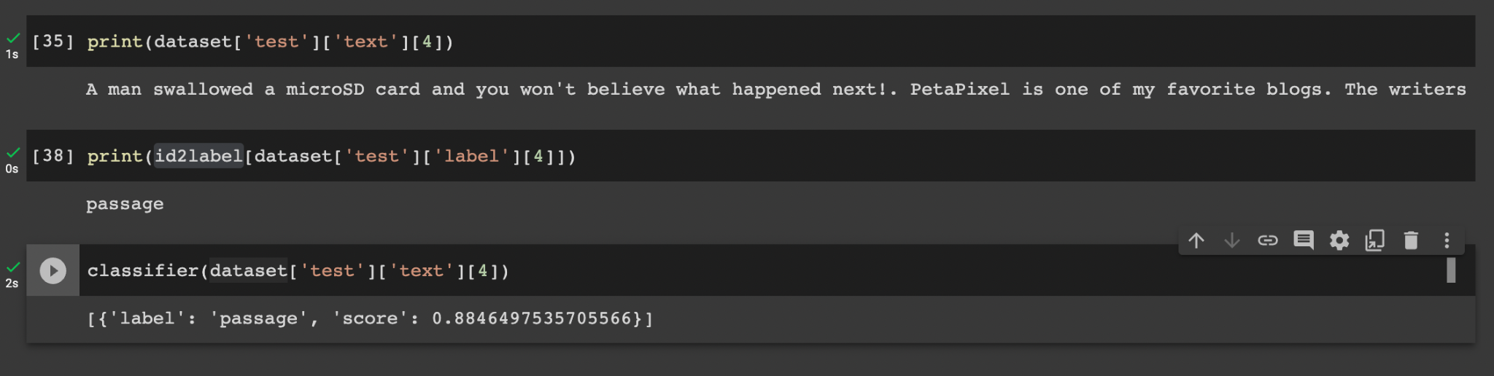
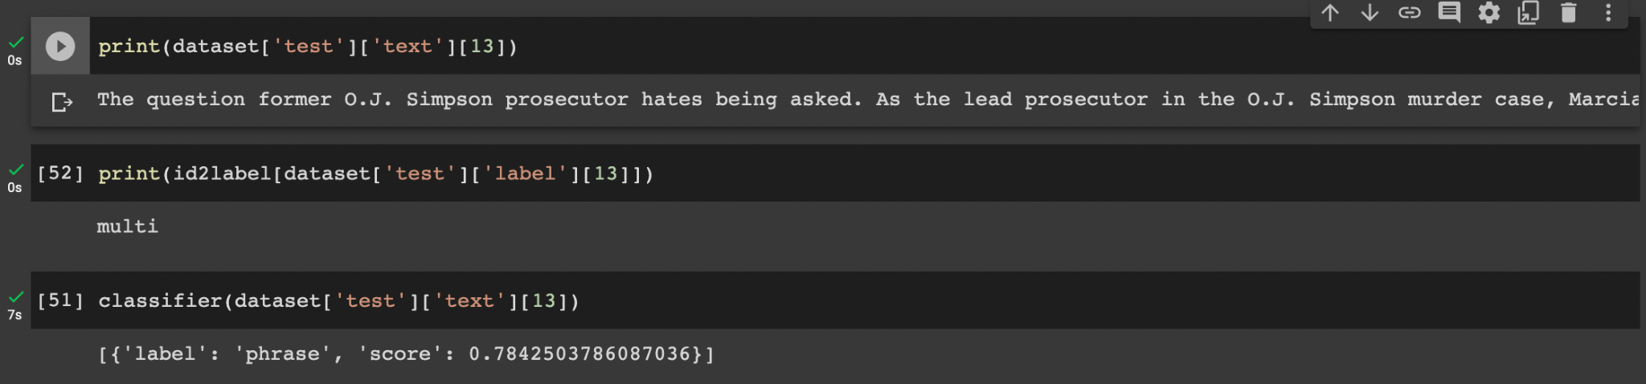
TASK 1 - Results
Notes:
M

Slide 9
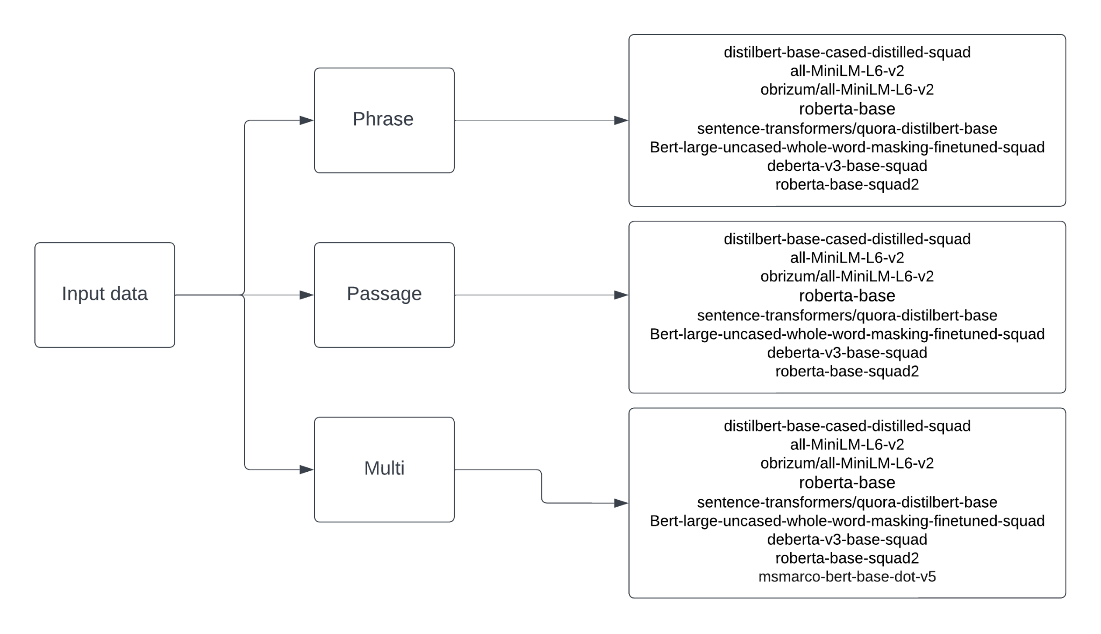
Task 2 Methods
Notes:
J

Slide 10
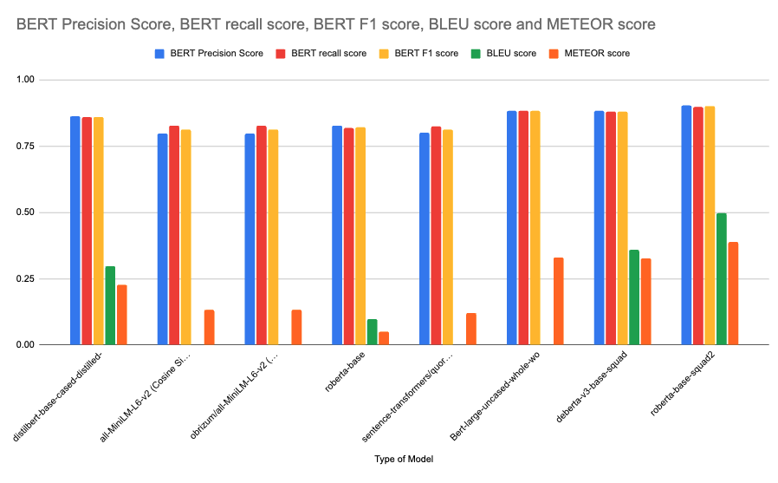
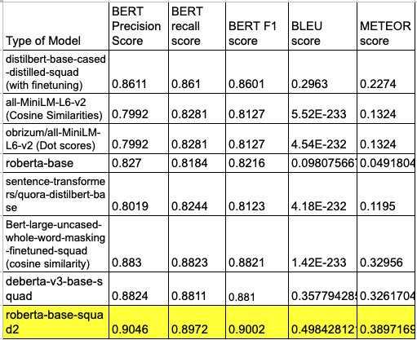
TASK 2 - Results for Phrase
Notes:
J

Slide 11
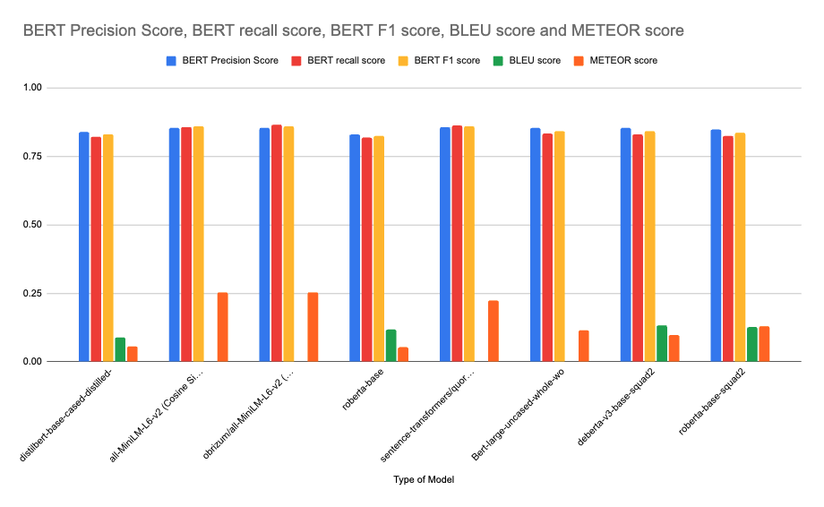
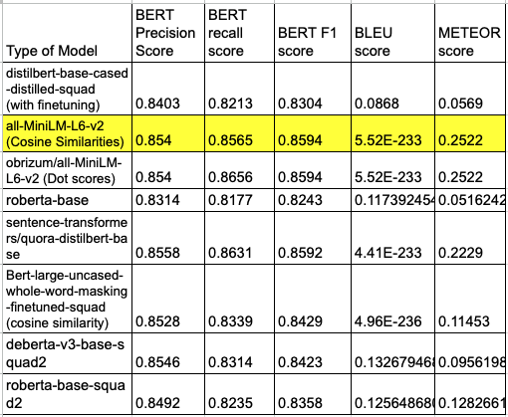
TASK 2 - Results for Passage
Notes:
J

Slide 12
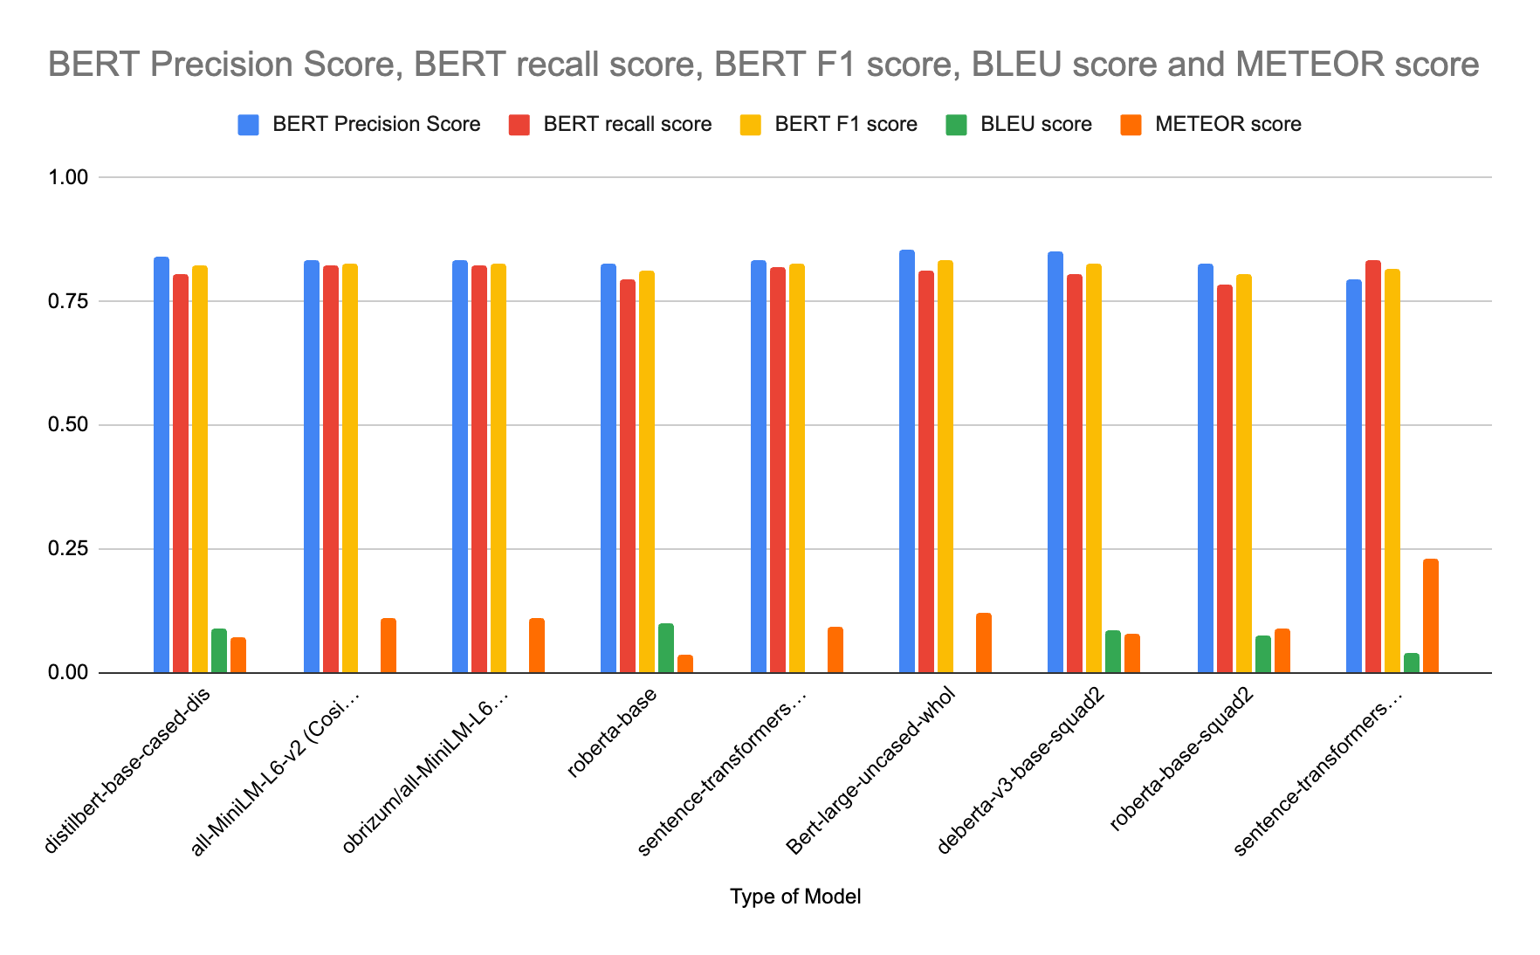
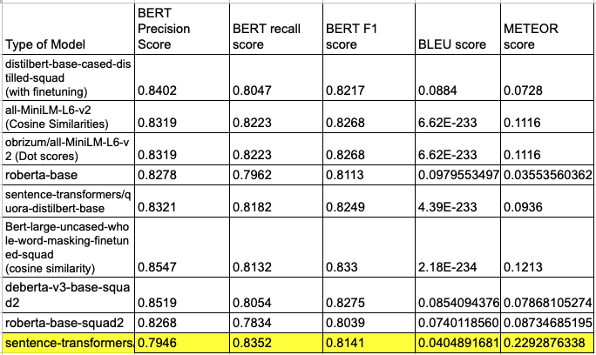
TASK 2 - Results for Multi
Notes:
J

Slide 13
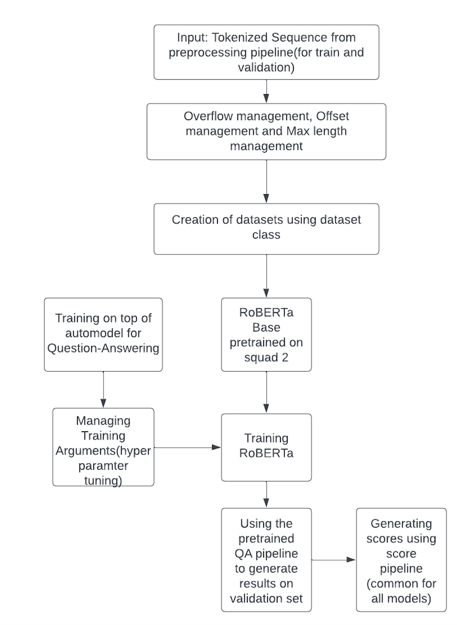
Task 2 - Phrase
RoBERTA-base-squad2
Architecture
(State of the Art)
Notes:
N

Slide 14
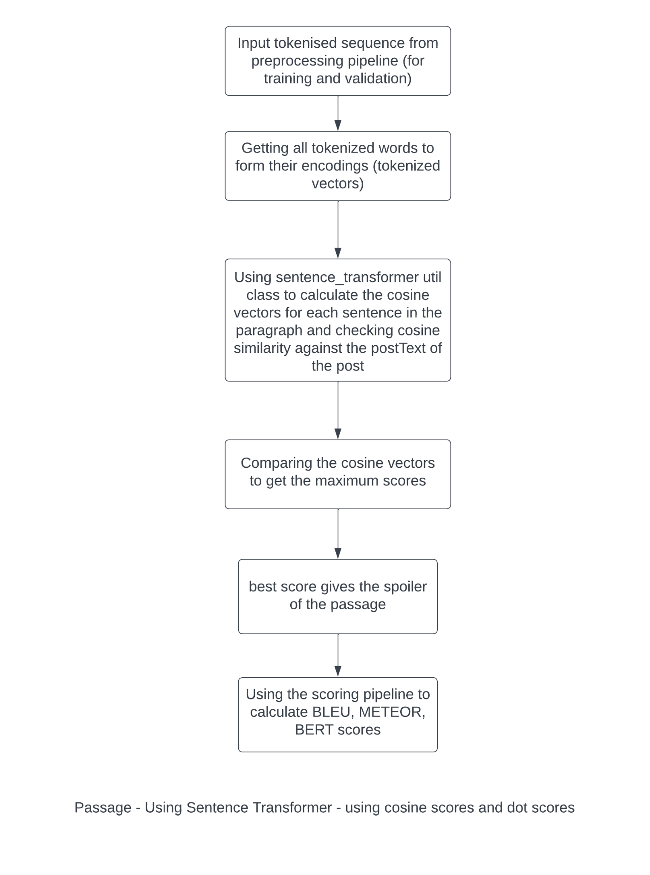
TASK 2 - Passage
Sentence_Transformer - ReRanking
all-MiniLM-L6-v2
(Cosine Similarities)
(State of the Art)
Notes:
N

Slide 15
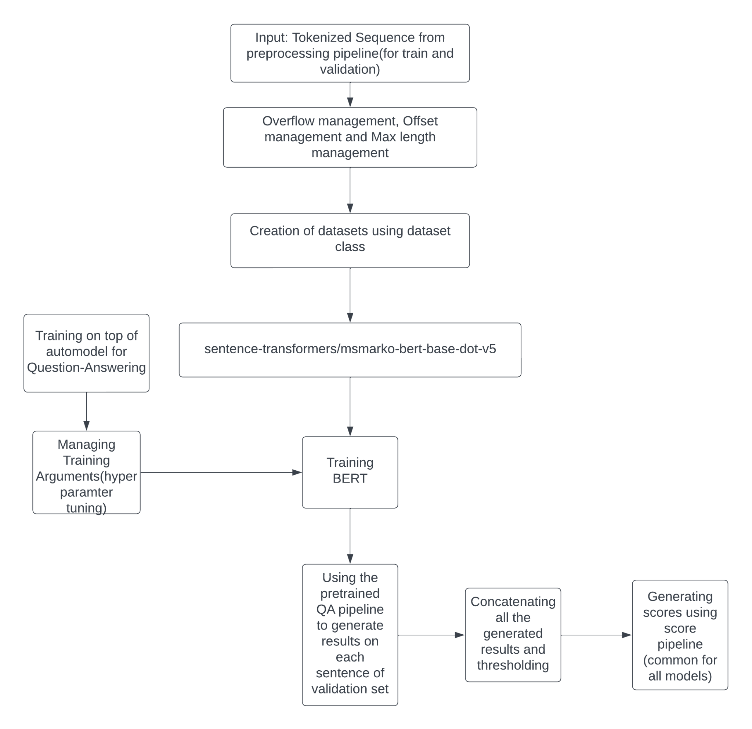
TASK 2 - Multi
Sentence-transformer/msmarco-bert-base-dot-v5
(State of the Art)
Notes:
N

Slide 16
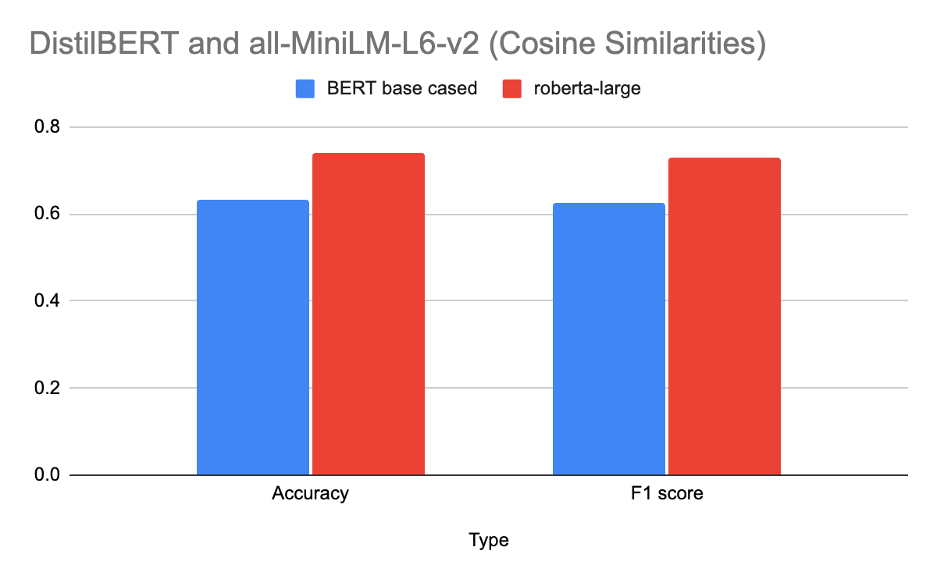
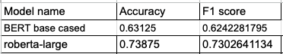
TASK 1 - Comparison between SOTA and Baseline results (milestone 2)
Notes:
J

Slide 17
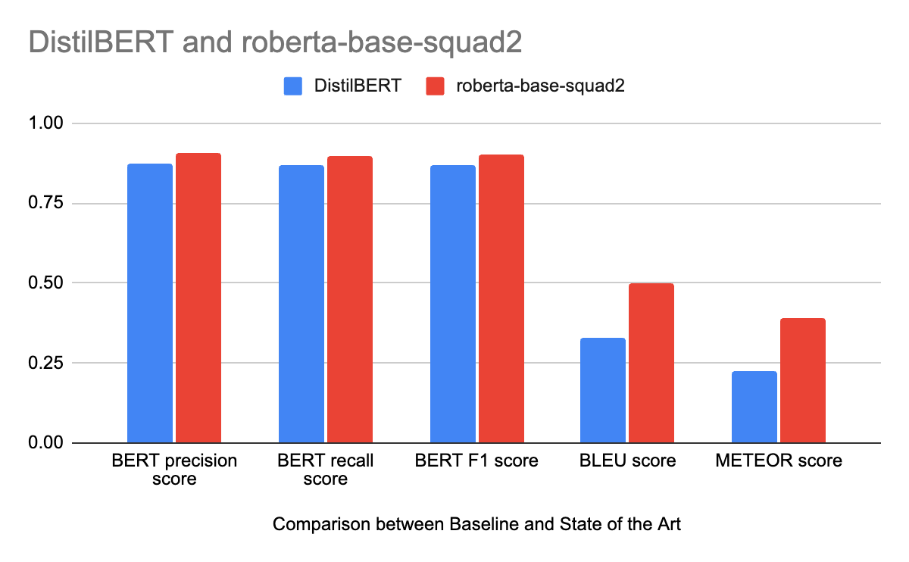
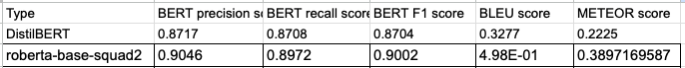
TASK 2 - Phrase
Comparison between SOTA and Baseline results (milestone 2)
Notes:
J

Slide 18
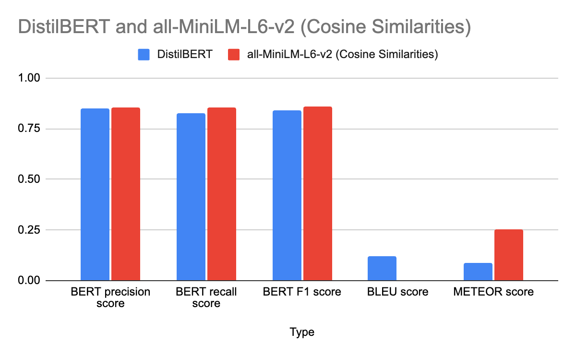
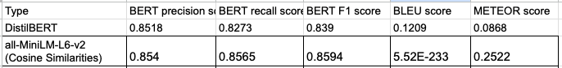
TASK 2 - Passage
Comparison between SOTA and Baseline results (milestone 2)
Notes:
J

Slide 19
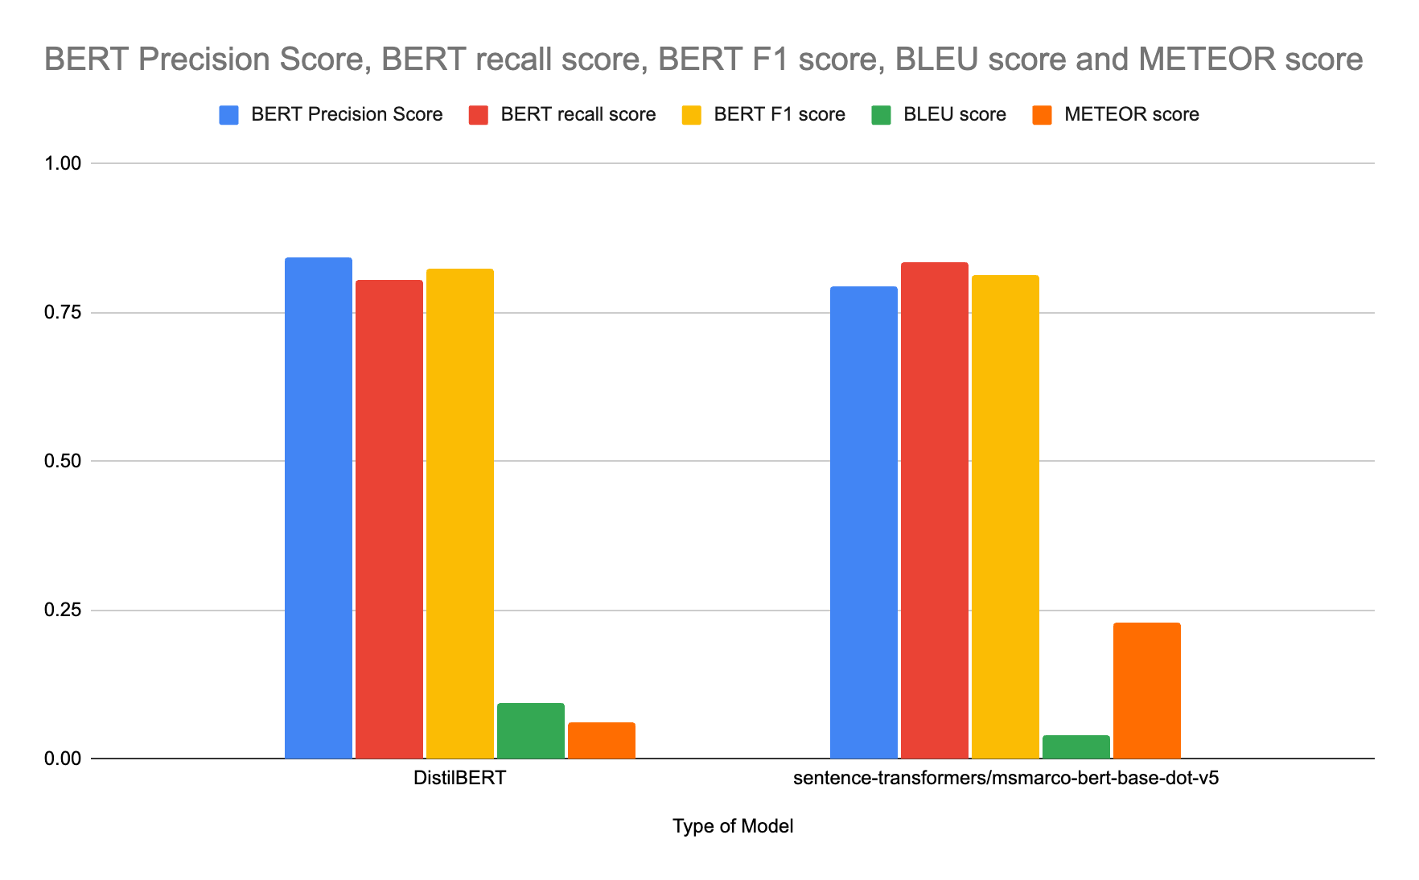
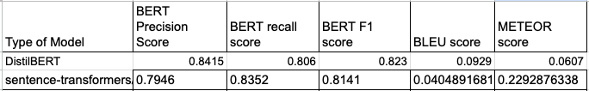
TASK 2 -Multi
Comparison between SOTA and Baseline results (milestone 2)
Notes:
J

Slide 20
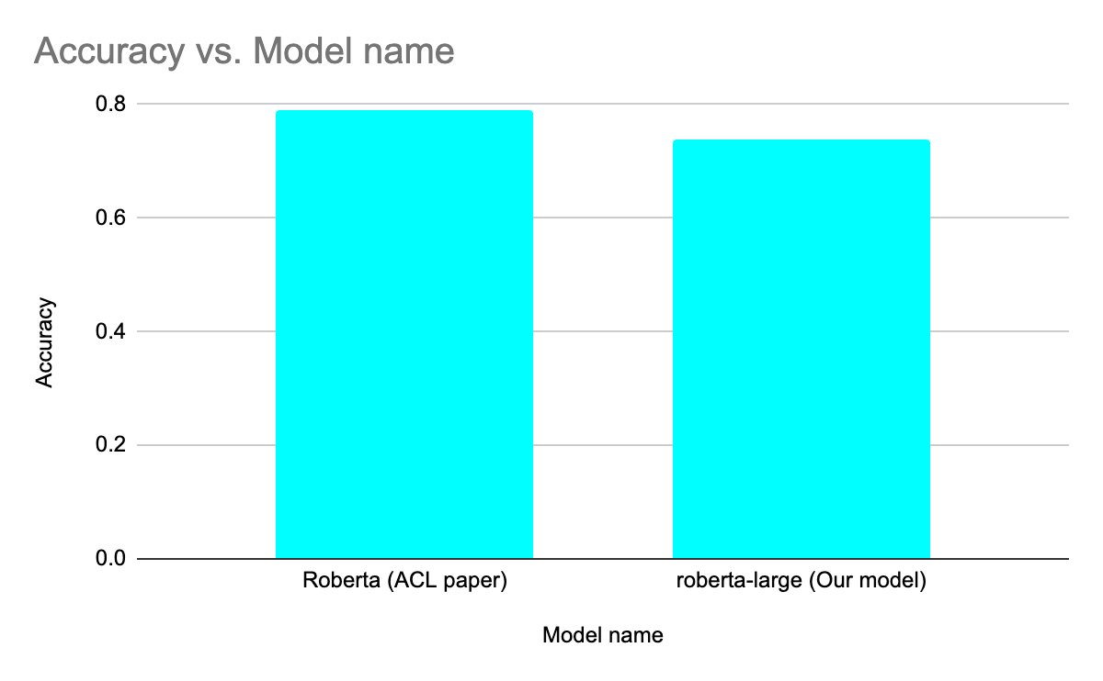
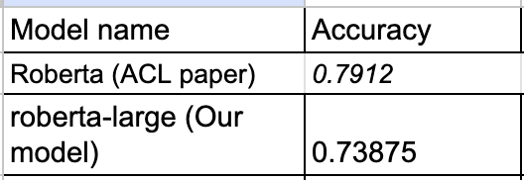
TASK 1 - Classification
Comparison between ACL Paper and SOTA
Notes:
J

Slide 21
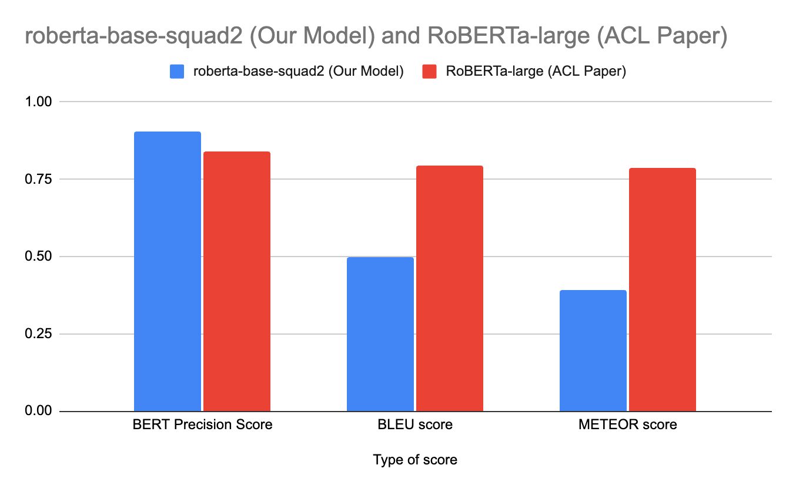
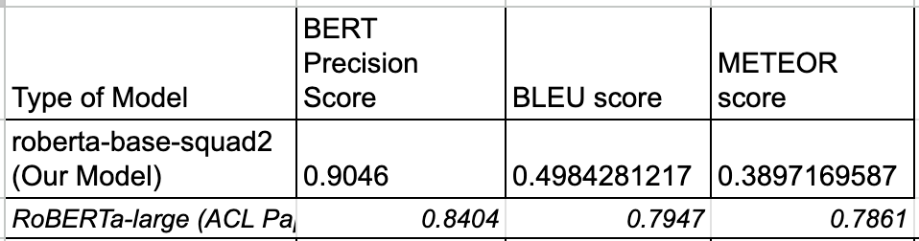
TASK 2 - Phrase
Comparison between ACL Paper and SOTA
Notes:
J

Slide 22
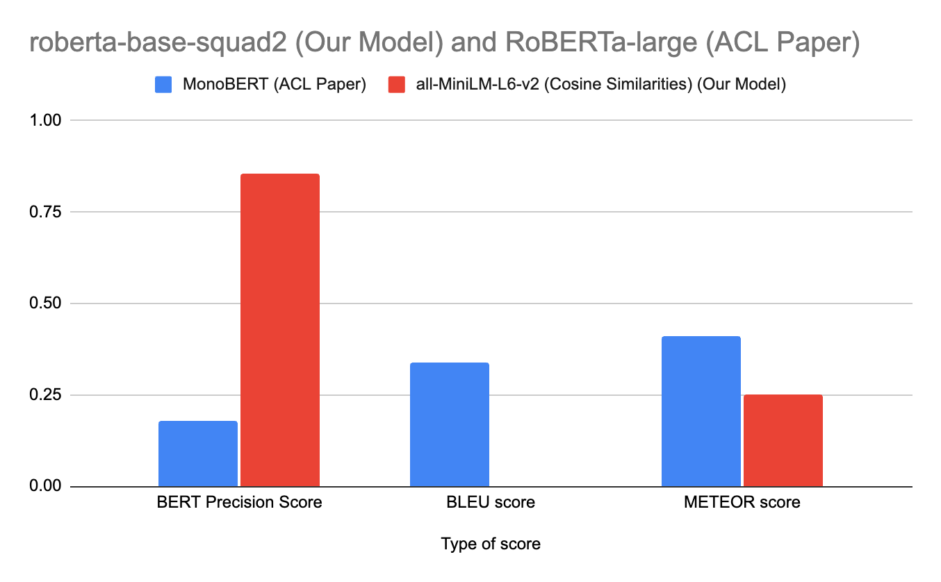
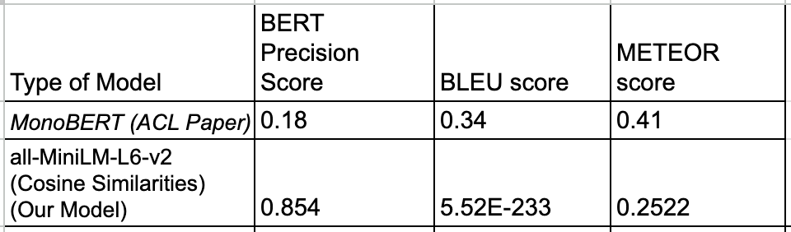
TASK 2 - Passage
Comparison between ACL Paper and SOTA
Notes:
J

Slide 23
TASK 2 - Multi
Comparison between ACL Paper and SOTA
Type of Model | BERT Precision Score | BLEU score | METEOR score
No results from Paper | NA | NA | NA
sentence-transformer MSMARCO | 0.79 | 0.04 | 0.22
Notes:
J

Slide 24
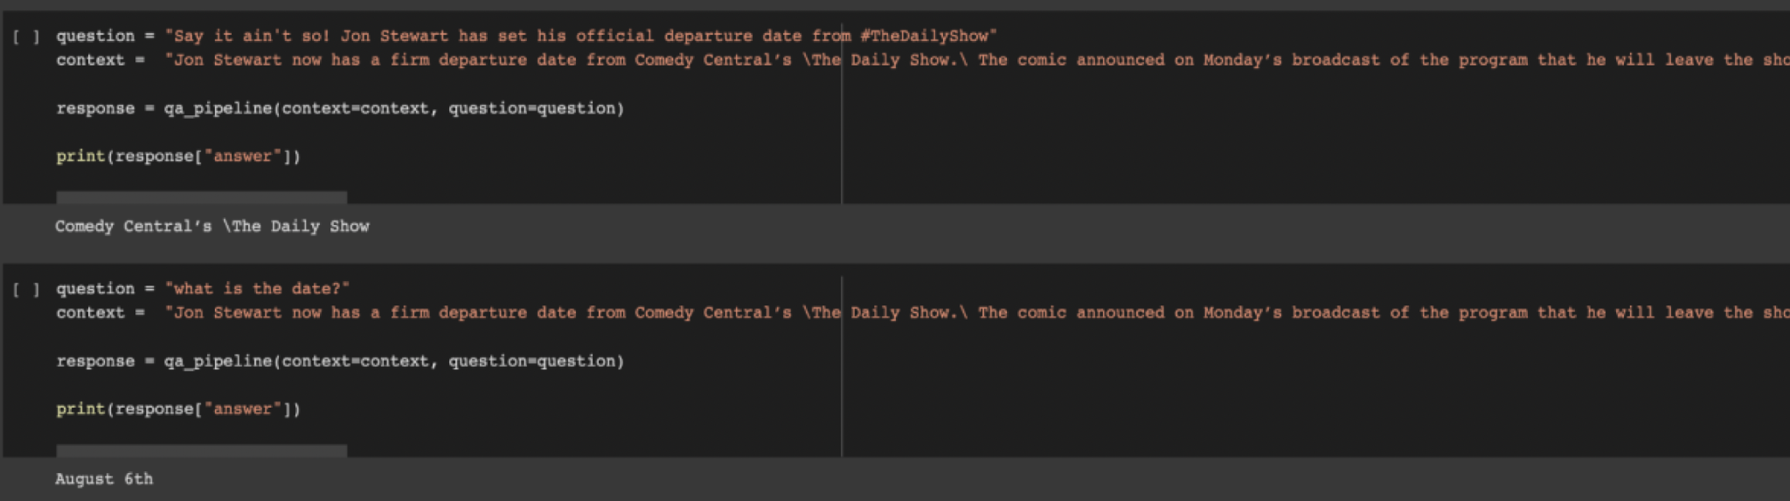
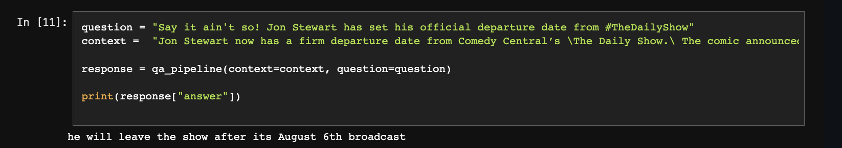
TASK 2 - Examples
Notes:
N

Slide 25
Thank You
Notes:
J

